Slide 1
PHD Progression
Explainable AI with Visual analytics

Slide 2
1. BLIP: Bootstrapping Language-image pre-training for Unified Vision-Language Understanding and Generation
Understanding-focused models (e.g., CLIP, ALBEF)
Generation-focused models (e.g., SimVLM)
No model excels at both tasks, and most models rely on noisy web-scraped captions, which affects the learning quality. BLIP resolves these two problems.

Slide 3
BLIP: Bootstrapping Language-image pre-training for Unified Vision-Language Understanding and Generation
Multimodal mixture of Encoder-Decoder (MED): a new model architecture for effective multi-task pre-training and flexible transfer learning. An MED can operate either as a unimodal encoder, or an image-grounded text encoder, or an image-grounded text decoder.
Captioning and Filtering: a captioner to produce synthetic captions given web images, and a filter to remove noisy captions from both the original web texts and the synthetic texts.

Slide 4
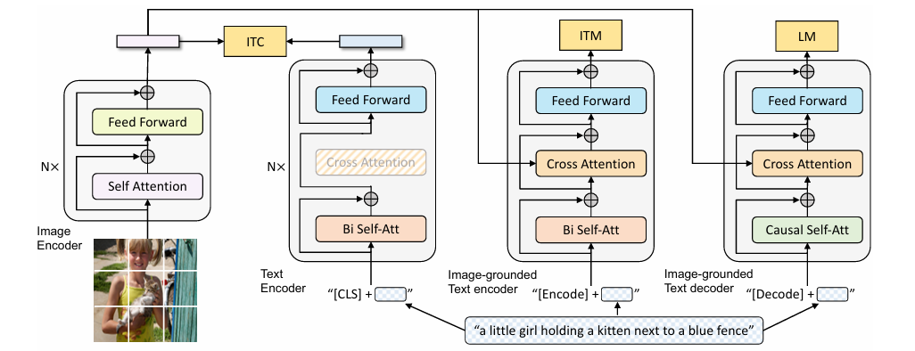
BLIP: Bootstrapping Language-image pre-training for Unified Vision-Language Understanding and Generation
ITC – Aligns image/text embeddings
ITM – Determines if an image-text pair matches
LM – Text generation given an image

Slide 5
BLIP: Bootstrapping Language-image pre-training for Unified Vision-Language Understanding and Generation
Mode | Purpose | Activated By
Unimodal Encoder | Align image/text representations | Contrastive loss (ITC)
Image-grounded Text Encoder | Fine-grained image-text reasoning | Matching loss (ITM)
Image-grounded Text Decoder | Generate captions | Language Modeling loss (LM)

Slide 6
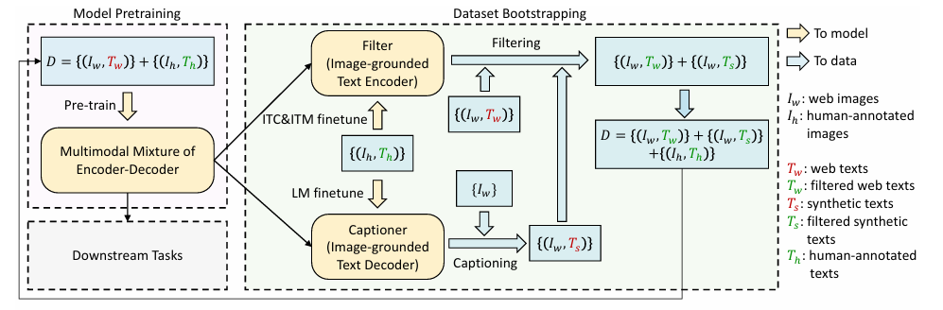
CapFilt Pipeline
Captioner (fine-tuned MED decoder)
Generates synthetic captions for web images using nucleus sampling (more diverse).
Filter (fine-tuned MED encoder)
Removes bad/noisy captions (both original and synthetic) using learned image-text matching.
Bootstrapped dataset = human-annotated + filtered synthetic + filtered original web captions

Slide 7
BLIP: POC
Component | Responsibility
Flask Backend (app.py) | Loads BLIP model, runs image encoding, executes greedy decode loop, extracts cross-attention tensors per token per layer, normalises and returns them as JSON.
D3.js Frontend (index.html) | Accepts base64 image from user, posts to backend, receives attention matrix, and renders 4 linked interactive visualizations: overlay, spatial heatmap, cross-attention matrix, and token bar chart.
REST API (/analyze) | Stateless POST endpoint receiving base64 image + optional text, returning caption, tokens, and a (T x 576) attention matrix.
BLIP Model | Salesforce blip-image-captioning-base: ViT-B/16 vision encoder producing 576 patch embeddings + 1 CLS, followed by a BERT-like text decoder with 12-layer cross-attention to those patches.
This tasks focuses on Caption generation and showing the attention between token and image patches
Spatial Saliency Map The output is a 24×24 map assigning an importance score to each image patch, which is the same form as GradCAM or LIME superpixel explanations — making cross-attention results directly comparable to gradient-based methods in user studies.

Slide 8
Blip: POC
BLIP has two types of attention internally:
Self-attention (within the text decoder): each token attending to previous tokens — explains language generation order, not image grounding
Cross-attention (text decoder → vision encoder): each text token attending to image patches — this is the multimodal bridge and the only attention type that can produce image-grounded explanations

Slide 9
Challenges of developing Blip: POC
BLIP generate() uses custom internal decode loop written directly inside BlipForConditionalGeneration. It does not call self.text_decoder as a stand alone PyTorch module, model.text_decoder therefore never triggered. This is bypassed with a manual greedy decode.
Matching the token lengths in the front end and backend so visualizations can be rendered.

Slide 10
From a research standpoint, the invariant patches are scientifically meaningful. They reveal:
Which image regions the model uses as persistent spatial anchors regardless of what word is being generated
That BLIP's cross-attention has a strong position prior independent of semantic content
That naive attention averaging is insufficient as an explanation method — the invariant patches are artefacts of aggregation, not genuine cross-modal alignment

Slide 11
3. Recent Application of Explainable AI(XAI): A Systematic Literature review
Which domains are most actively using XAI?
Which XAI techniques and explanation forms are used?
How are XAI explanations evaluated?

Slide 12
Top domains
Healthcare & medicine
Environmental & agricultural systems
Industrial & manufacturing
Cybersecurity & defence
Finance
Transportation & autonomous systems
Education, psychology, legal, and social science (smaller but growing)

Slide 13
Most Common XAI Methods Used
Local explanations dominate (53% of papers), followed by mixed global+local (29%). Very few papers use purely global explanations.
Most popular techniques:
SHAP – by far the most used
Has mathematical guarantees (efficiency, symmetry, additivity)
Considered more stable than LIME
LIME – widely used but criticized for instability
Anchors – used far less frequently

Slide 14
Most Common XAI Methods Used
For image data, the most used gradient‑based methods include:
Grad-CAM / Grad-CAM++
SmoothGrad
Integrated Gradients
Layer-wise Relevance Propagation (LRP)

Slide 15
Most Common XAI Methods Used
Global model-agnostic methods:
Partial Dependence Plots (PDP)
Accumulated Local Effects (ALE)
Permutation Feature Importance
Intrinsic (ante-hoc) models:
Decision trees
Logistic regression

Slide 16
ML Models & Tasks Used
Across all papers:
Most used model families:
Neural networks (59%)
Tree-based models (37%)
Support Vector Machines (11%)
Logistic/Linear Regression (9%)

Slide 17
ML Models & Tasks Used
Main ML tasks:
Classification – 70%
Regression – 21%
Clustering – 4%
Reinforcement learning – 1%

Slide 18
Evaluation of XAI Methods is a Major Weakness
Heavy reliance on anecdotal interpretation
Qualitative reasoning or expert opinion only
Very few quantitative explainability metrics
Lack of standardized evaluation frameworks

Slide 19
4. Visual Analytics for Explainable AI
What Is Visual Analytics in XAI?
Interactive visual interfaces, and Algorithmic explanation techniques

Slide 20
Visualization Techniques for Explaining AI
Local & Feature‑Based Explanations
Saliency maps (images)
Heatmaps, feature attribution plots
Layer-wise relevance propagation (LRP)
Grad‑CAM for deep networks These reveal which input features influenced predictions.

Slide 21
Visualization Techniques for Explaining AI
Global Structure & Behavior
Dimensionality reduction (t‑SNE, UMAP) to visualize internal model representations
Decision trees & rule-based visuals for interpretable logic
Performance dashboards (confusion matrices, ROC curves, error distributions) Tools like TensorBoard and Microsoft InterpretML enable interactive debugging and exploration.

Slide 22
Challenges Identified
Technical Challenges
Difficulty visualizing high‑dimensional, nonlinear model behavior
Scalability issues for large models and big datasets
Distortion risks in attribution and dimensionality reduction techniques
Ethical & Human-Factor Challenges
Explanations can hide or amplify bias
Diverse users require different types of explanations
Risk of over-reliance or misinterpretation of visualizations .

Slide 23
Evaluation & User-Centered Design
User studies
Task performance analysis
Feedback on trust, usability, cognitive load

Slide 24
Future Directions
Multimodal AI
Visual tools must explain models combining text, images, audio, etc.
Generative AI & Foundation Models
New explanation challenges for large-scale models.
Standardized Explainability Metrics
Driven by policy and regulatory frameworks.
Responsible AI
Visual analytics will increasingly support fairness, accountability, and transparency in real‑world deployments.

Slide 25
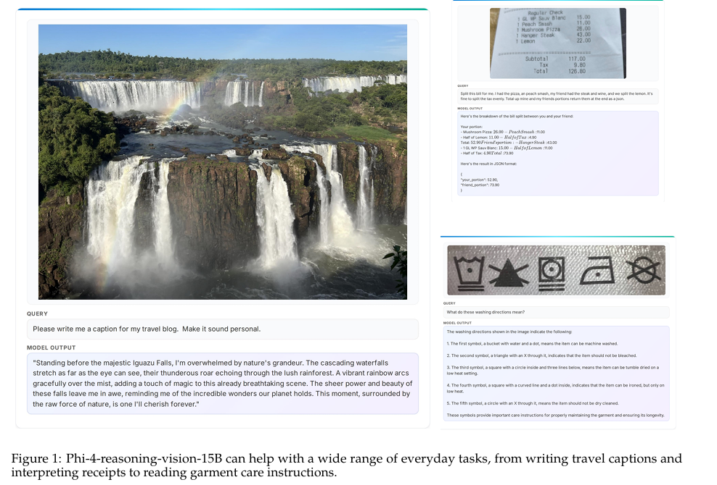
5. Phi-4-reasoning-vision-15B Technical Report
Phi‑4‑Reasoning‑Vision‑15B is an open‑weight, compact (15B parameter) multimodal model designed to perform vision–language tasks with strong mathematical, scientific, and GUI‑reasoning abilities.

Slide 26
Phi-4-reasoning-vision-15B Technical Report
The paper contributes:
A mid‑fusion multimodal architecture combining SigLIP‑2 and Phi‑4‑Reasoning.
A high‑resolution dynamic‑resolution vision encoder for fine-grained perception.
A mixed reasoning / non‑reasoning training strategy enabling the model to “decide” when to think.
An emphasis on extreme data quality improvements, including filtering, regeneration, augmentation, and error correction of open datasets.
Evidence that small models can push the Pareto frontier in the accuracy‑vs‑compute tradeoff.

Slide 27
Phi-4-reasoning-vision-15B Technical Report
The paper contributes:
A mid‑fusion multimodal architecture combining SigLIP‑2 and Phi‑4‑Reasoning.
A high‑resolution dynamic‑resolution vision encoder for fine-grained perception.
A mixed reasoning / non‑reasoning training strategy enabling the model to “decide” when to think.
An emphasis on extreme data quality improvements, including filtering, regeneration, augmentation, and error correction of open datasets.
Evidence that small models can push the Pareto frontier in the accuracy‑vs‑compute tradeoff.

Slide 28
Phi-4-reasoning-vision-15B Technical Report
Large VLMs increasingly depend on enormous datasets, long outputs, and computationally expensive reasoning. This limits deployment in real-world, interactive settings. Phi‑4‑Reasoning‑Vision‑15B seeks to be:
Strong at reasoning,
Efficient in inference,
Competent across tasks including GUI grounding, OCR, math, science, and general VQA.

Slide 29
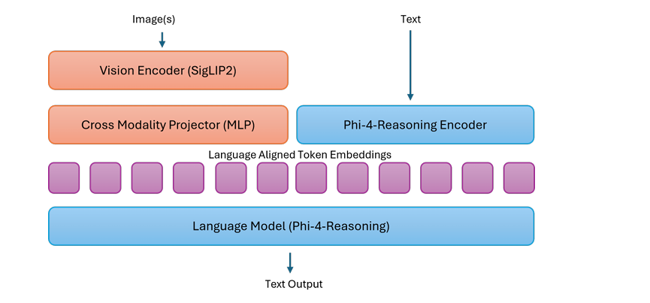
Architecture
SigLIP‑2 as vision encoder,
A learned MLP projector,
The Phi‑4‑Reasoning LLM backbone,
Interleaving visual tokens with text tokens.
Dynamic‑Resolution Encoder

Slide 30
Training Pipeline
MLP pretraining (align image–text spaces)
Full instruction tuning (single-image, diverse tasks)
Long‑context, multi-image & RAI (responsible AI, safety, document tasks)

Slide 31
Evaluation
Math (MathVista, MathVerse, MathVision)
Charts (ChartQA)
Documents (OCRBench)
GUI grounding (ScreenSpot)
General multimodal reasoning (MMMU, AI2D)

Slide 32
Contributions of the Paper
1. A compact, efficient multimodal reasoning model
Rigorous data filtering,
Dynamic resolution perception,
Efficient reasoning training.
2. Systematic ablation of vision encoder strategies. Dynamic resolution with large token budgets performs best.

Slide 33
Contributions of the Paper
3. Mixed-mode reasoning framework: A practical approach for controlling reasoning behaviour without reinforcement learning or excessive data.
4. Strong GUI grounding & computer-use abilities: Thanks to high‑resolution perception and curated GUI datasets.
5. High-quality, curated open-source data pipeline: A data-centric contribution with broad value for the community.

Slide 34
Gaps in Research (Open Problems Identified in the Paper)
Dynamic resolution improves performance but increases cost quadratically with tokens.
The boundary between reasoning and non‑reasoning is still implicitly learned
The ratio between math, GUI, and general data is unresolved at larger scales
Handling extreme data imbalance
Fine-grained image understanding remains limited
Safety in multimodal contexts

Slide 35
Gaps in Research (Open Problems Identified in the Paper)
Dynamic resolution improves performance but increases cost quadratically with tokens.
The boundary between reasoning and non‑reasoning is still implicitly learned
The ratio between math, GUI, and general data is unresolved at larger scales
Handling extreme data imbalance
Fine-grained image understanding remains limited
Safety in multimodal contexts

Slide 36
Future Work Suggested by the Paper
Text-conditioned adaptive vision tokenization
Improving reasoning-mode switching
Large-scale experiments on data composition
Better grounding and high-resolution perception
Enhanced safety for multimodal reasoning
Release of training data

Slide 37
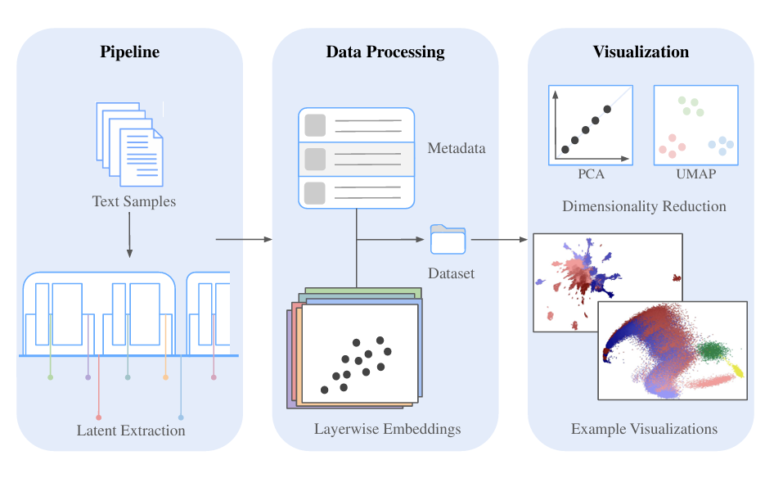
Visualizing LLM Latent Space Geometry Through Dimensionality Reduction
A full pipeline for extracting and visualizing LLM latent states
The paper develops a three‑stage workflow:
Latent state extraction from multiple capture points inside each Transformer block.
Data processing (filtering, aggregation, and optional preliminary PCA).
Dimensionality reduction & visualization using PCA/UMAP. This enables reproducible geometric analysis of LLM internals.

Slide 38
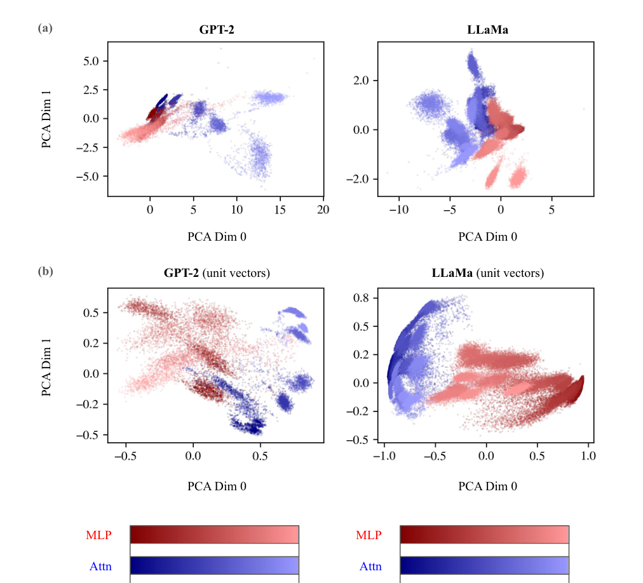
Discovery of a new geometric signature: MLP vs. Attention separation
The authors observe a clear geometric separation between the latent outputs of:
Attention modules and
MLP modules

Slide 39
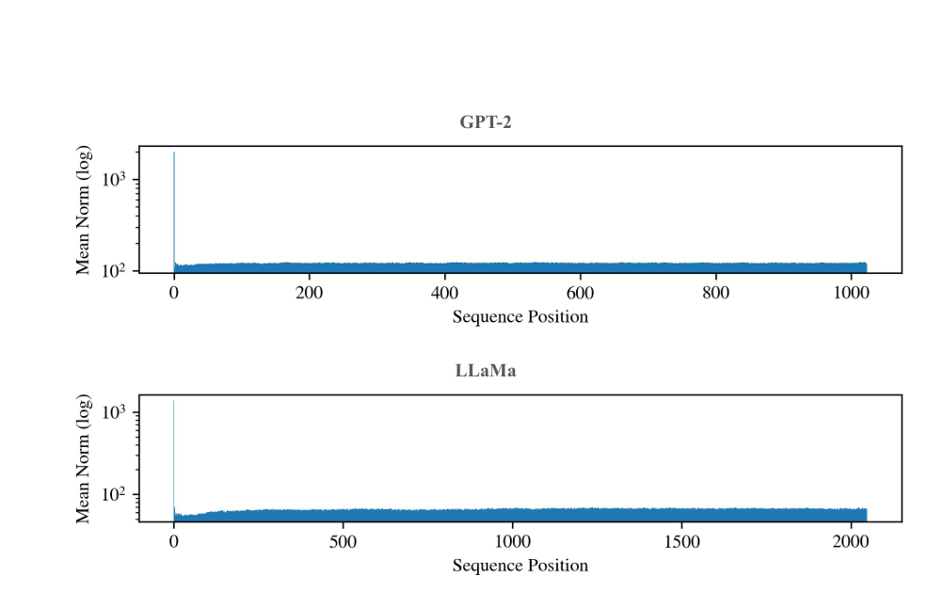
Analysis of high-norm latent states at the initial sequence position
The 0‑th token position (initial token) exhibits unusually high vector norms, even for normal vocabulary tokens in LLaMa. This:
And impacts dimensionality reduction due to norm outliers. This suggests models implement special mechanisms for the initial token.

Slide 40
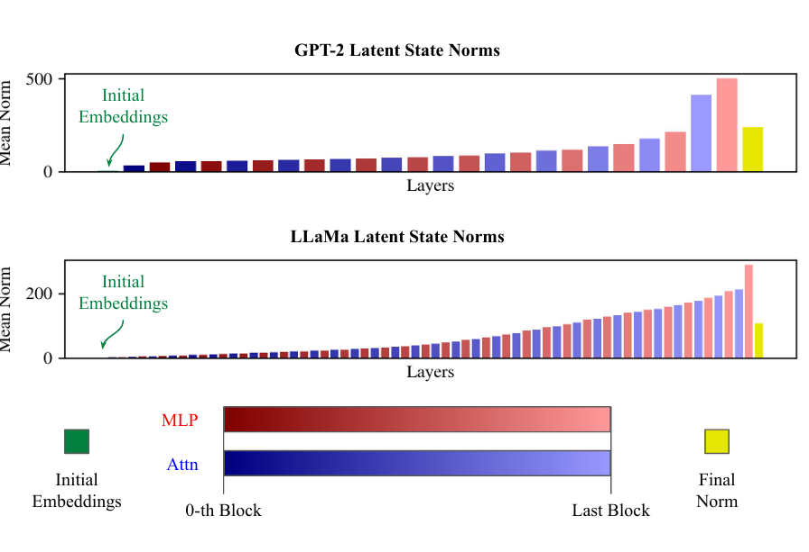
Visualization of layerwise evolution of latent states
Latent state norms rise across layers
Peaks near the final transformer block
Drop after the final normalization layer. PCA visualizations reveal clear layerwise trajectories in latent space for both GPT‑2 and LLaMa.

Slide 41
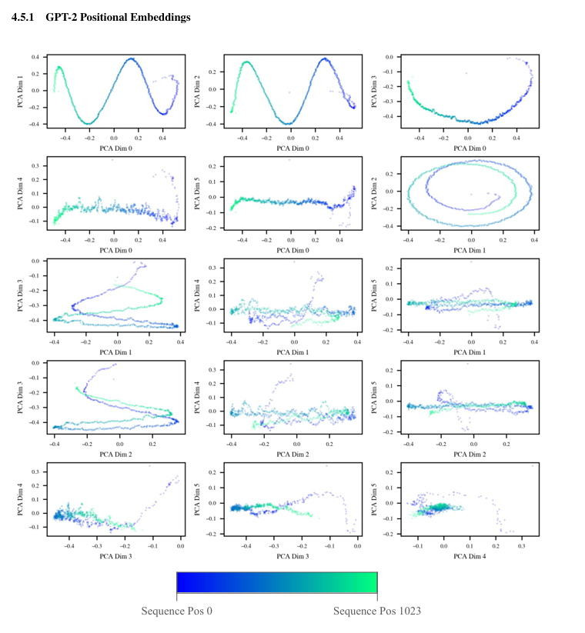
Geometric structure of positional information
GPT‑2 (learned embeddings):
Exhibits a helical high-dimensional positional structure, consistent with prior findings.
Visible across multiple PCA dimensions.

Slide 42
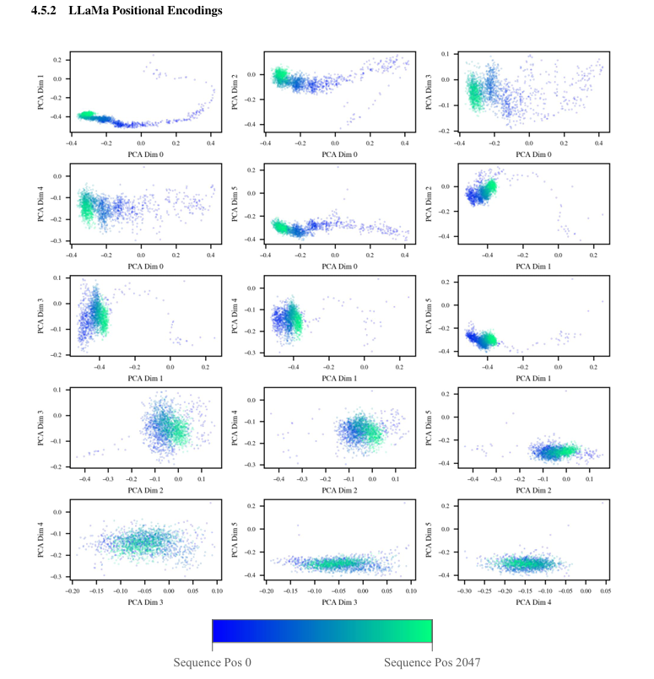
Geometric structure of positional information
LLaMa (RoPE):
Shows lower‑dimensional geometric patterns,
With early sequence positions forming long “tails” before converging,
But less pronounced than GPT‑2 because RoPE interacts differently with attention.

Slide 43
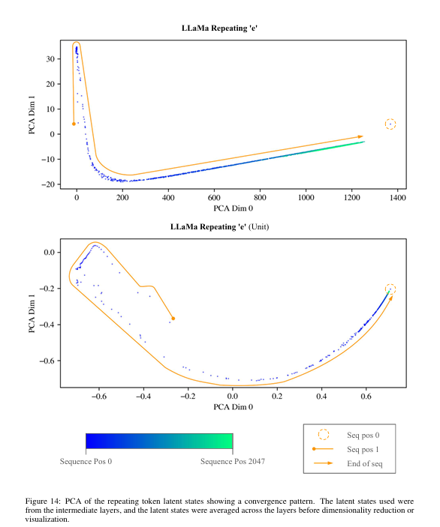
Repeating token experiment (new behavioral insight) For LLaMa, repeated “e” tokens show:
For LLaMa, repeated “e” tokens show:
Convergence of latent states over long sequences,
Later tokens drift toward a direction similar to the <BOS> token,
Matching prior observations about “massive activations”. This suggests RoPE-based models may normalize repeated contexts by compressing long repeated sequences into a stable representation.

Slide 44
Feedback
Focus more on text based LLMs only.
What are their key challenges to make them trustworthy?
Develop clustering based PoCs with d3.js
Cite only peer reviewed papers(journals, conferences)
Avoid technical jargon and explain them in simple words.

